Slide 1
HOW TO CREATE YOUR OWN LIBRARY IN C?
Ever wondered how you build your own library In C Program?

Slide 2
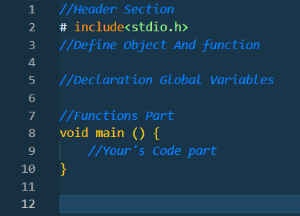
WHAT IS HEADER FILE?
Header File Is Pre-define Library or preprocessor In C. Like #include<stdio.h>, A C header file is a text file that contains pieces of code written in the C programming language.

Slide 3
Why Need To Create Header File?
In C programming, a header file is a separate file that contains declarations of functions, constants, and data structures that are used across multiple source code files. Custom header files can help organize your code, improve maintainability, and promote code reusability. Let's discuss how to create a custom header file in C.

Slide 4
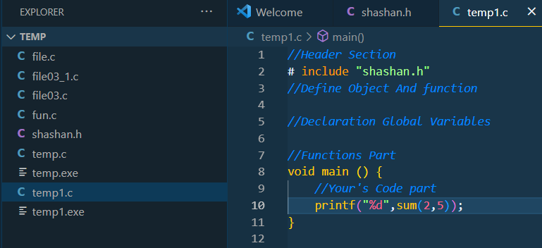
Create Header File For Local File(Program)
For Local File You Can Create Library, It Works For Current Folder Not Any Folder.
Header Code Is #include “shashan.h”

Slide 5
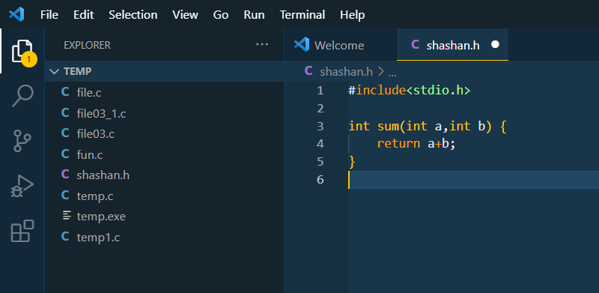
Header File Demo In Local Files

Slide 6
How To Make A local Library Global?
Your Dream Is To Make Standard Library Like #include<stdio.h>?
But How?

Slide 7
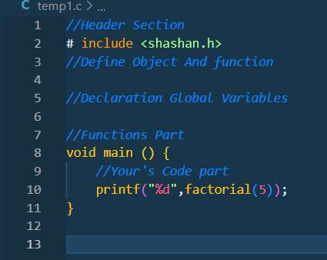
Compiler plays the main role to run the standard library or preprocessor.
#include<stdio.h> In line stdio.h is header file like my header file shashan.h
If My Library Converts To Global, It Can Be Used Just Like #include<stdio.h>

Slide 8
Let’s Find Where Is Standard Headers File In Compiler

Slide 9
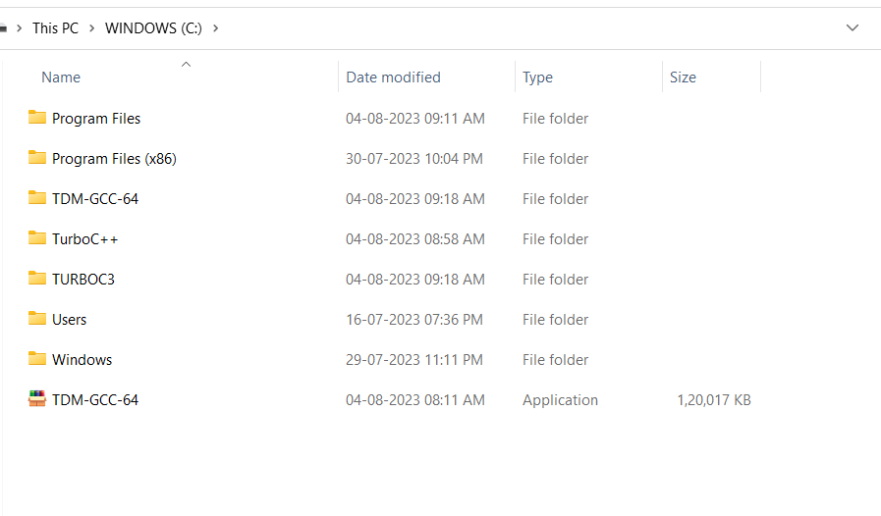
Find Where Is Your Compiler

Slide 10
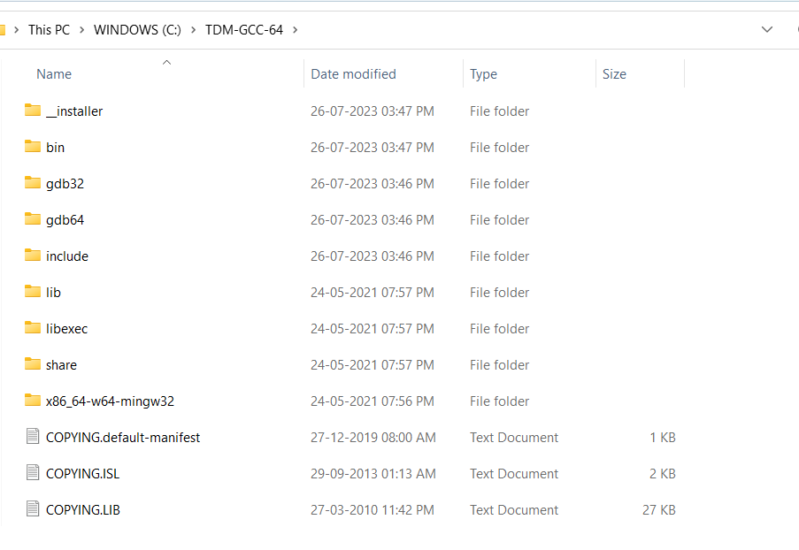
Go TO Lib File To Find Library

Slide 11
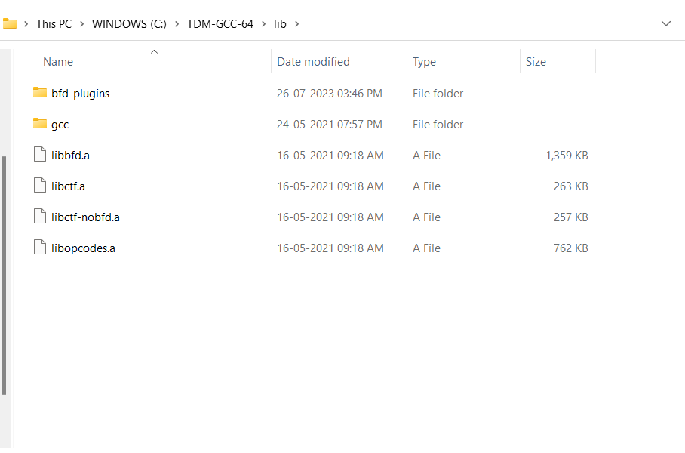
Go To gcc Folder.

Slide 12
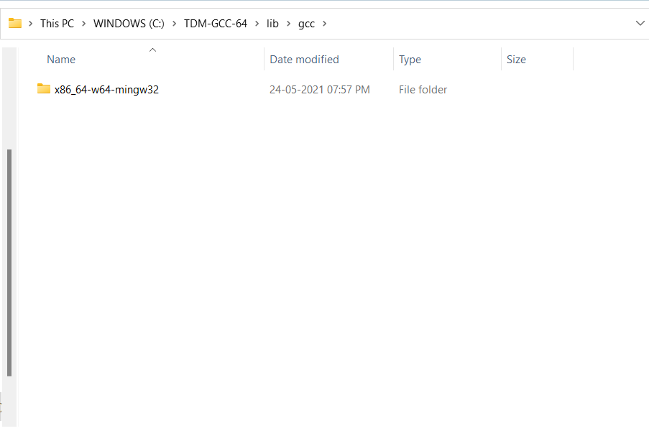
Click On This Folder

Slide 13
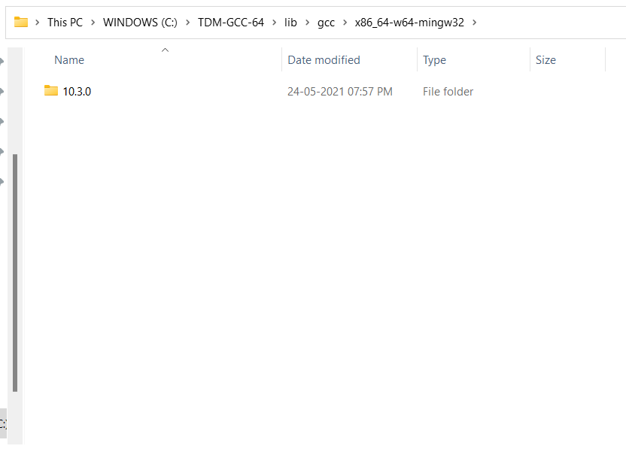
Click On This Forlder

Slide 14
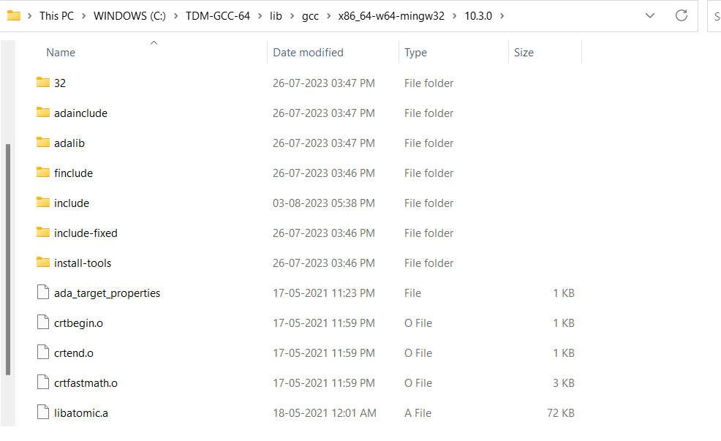
You Write #include<stdio.h> so call compiler and make request to access header file, all header files are save in include folder.

Slide 15
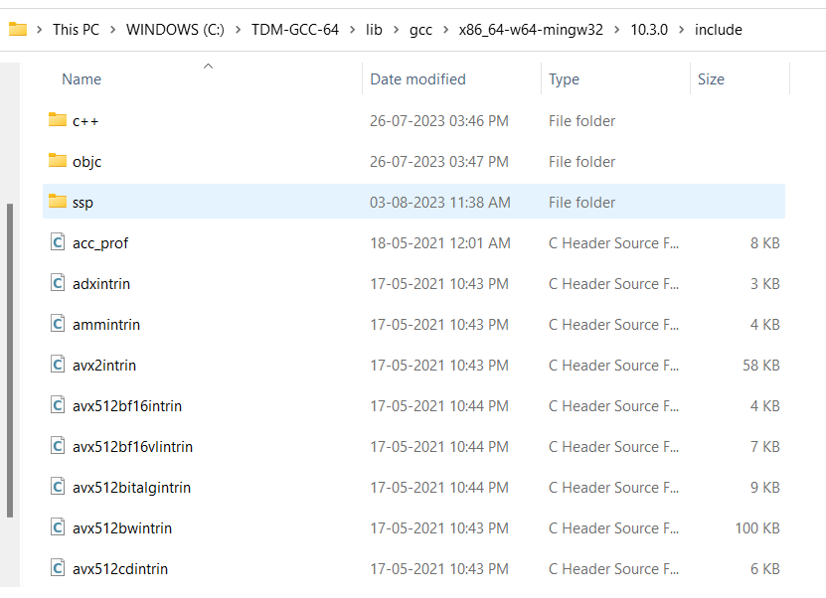
All Standard Header File is Available In This Folder So You Need Add Your Header File In This Folder.

Slide 16
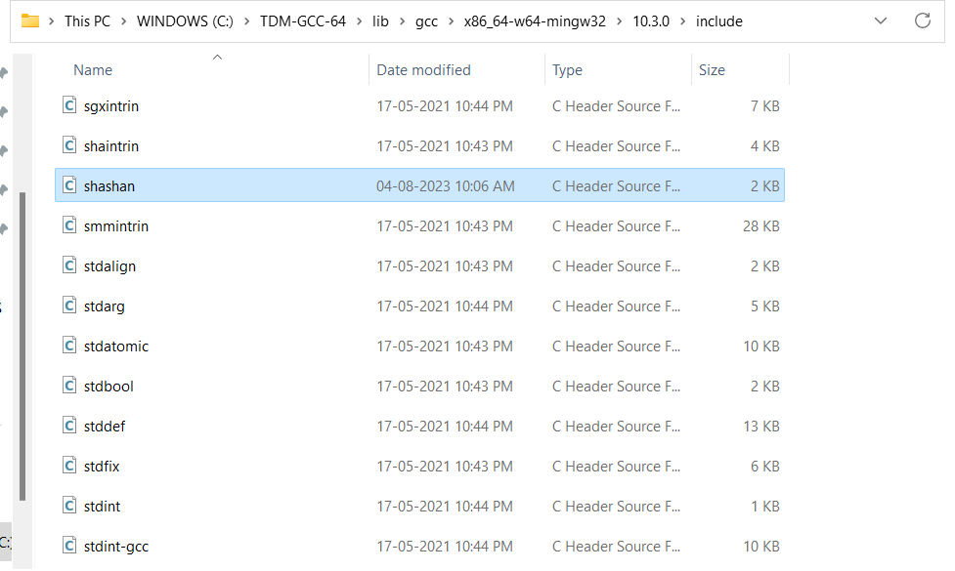
Add Your Header File Like This

Slide 17
How Add Library In Old Platform Like Turbo C
Turbo C Have Inbuild Complier.
First Step Is You Can Find Turbo C, Then Open “INCLUDE” Folder.
Paste Your Header File In This Folder.
In Turbo C have old compiler So some library are not work and some rules of code are follow else got errors.

Slide 18
Features of #include<shashan.h>
All Standard Library In Include One Library so you can use all function only need #include<shashan.h>
~>ADDITIONAL FUNCTIONS IN THIS LIBRARY
Find Factorial.
Check Prime Or Not.
Swap Two Variable Values.
Check Greatest Of Nth Numbers.
Find The Roots Of Quadratic Equation.
Find Sum Of Nth Netural Numbers.
Encryption & Decryption strings.
New Variable 'String' Using Typedef and New Function 'scans' This Scan Values Include Space.

Slide 19
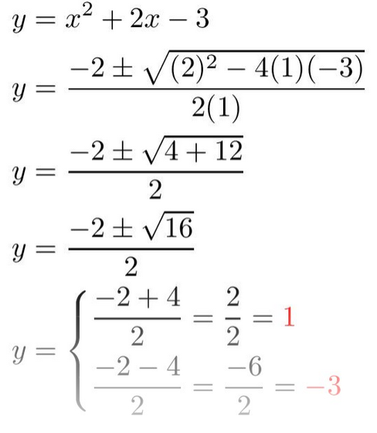
LETS START THE DEMO
EXAMPLE CODE
GCC FOLDER
HEADER FILE

Slide 20


https://sites.google.com/view/shashan-gcc
If You Want My Library Download Compiler.

Slide 21
THANK YOU
Special Thanks TO Charusat & Abhishek Sir.

